Slide 1

LAMBDA
CALCULUS
PRESENTED BY :
Ayush Billade (38)
Akshat Chandrapatle (45)
Srinivas Chenna (48)
Girish Chinchalpalle (49)
GUIDEBY:
DR. JYOTI KANJALKAR

Slide 2
TABLE OF CONTENTS
01
02
03
FREE & BOUND
VARIABLES
INTRODUCTION
SYNTAX
04
SUBSTITUTION
05
REDUCTION
06
LITERATURE REVIREW
02

Slide 3
INTRODUCTION
Alonzo Church as a way of formalizing the concept of effective computability. λ calculus is a universal model of computation equivalent to a Turing machine.
It also can be called the smallest universal programming language of the world. All function programming language can be viewed as syncretic variation of λ calculus.
Functional languages such as Lisp, Scheme, FP, ML, Miranda, and Haskell are an attempt to realize Church's lambda calculus in practical form as a programming language.
03

Slide 4
SYNTAX
Lambda expressions come in four varieties:
Variables, which are usually taken to be any lowercase letters.
Predefined constants, which act as values and operations are allowed in an impure or applied lambda calculus .
Function applications (combinations).
Lambda abstractions (function definitions).
The simplicity of lambda calculus syntax is apparent from a BNF specification of its concrete syntax:
<expression>::= <variable> ; lowercase identifiers
| <constant> ; predefined objects
| ( <expression><expression> ) ; combinations
| ( λ<variable> .<expression> ) ; abstractions
04

Slide 5
FREE AND BOUND VARIABLES
In λ calculus all names are local to definitions. In the function Ax.x we say that x is "bound" since its occurrence in the body of the definition is preceded by Xx.
A name not preceded by a λ is called a "free variable".
EX:
(λx.xy)
(xx.x)(Xy.yx)
(Ax.xy)(λy.y)
05

Slide 6
SUBSTITUTION
The substitution process is based on a set of rules that specify how a given expression can be replaced by another expression.
The basic idea behind substitution is that a given expression can be replaced by another expression as long as the two expressions are equivalent.
For example, the expression (λx.x) can be replaced by any expression of the form (λy.y).
Similarly, the expression (λx.x + y) can be replaced by (λz.z + y) as long as x and z are equivalent.
06

Slide 7
FUNCTION IN LAMBDA CALCULUS
A function is defined as a lambda abstraction
Syntax: λ<parameter>.<expression>
Focus on the rule for going from an argument to result.
Ignore the issues of naming the function and its domain and range.
Mathematical function: f(x) = x In the λ calculus: (λx. x)
(λx. x + 2), the argument is x and the result is x + 2.
07

Slide 8
The application of the identity function to A is represented by the expression ((λx.x) A).
The argument for the identify itself:
((λx.x) (λx.x))
Function take an argument, ignore it and return the identity function:
(λY.(λX.X))
Function take an argument, return a function that ignore its own argument and return the argument
Original Function: (λY.(λX.Y)).
08

Slide 9
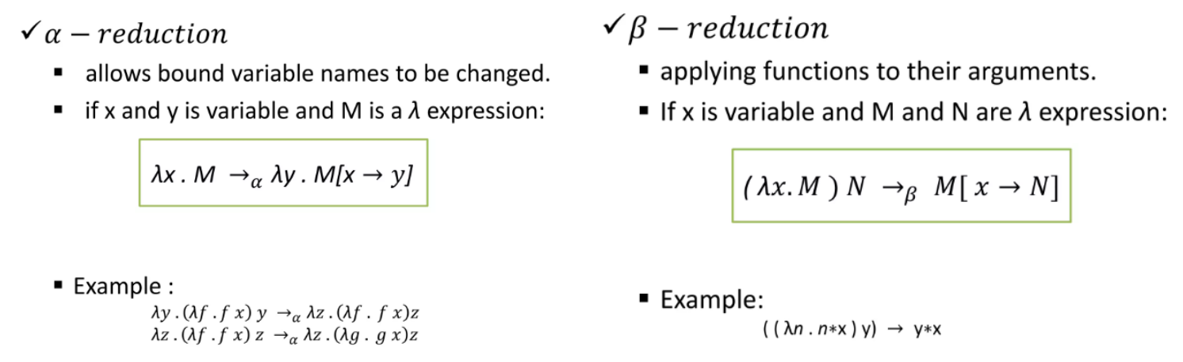
REDUCTION IN LAMBDA CALCULUS
ALFA-REDUCTION
BETA-REDUCTION
(λx.x + 1) 2 = 3
09

Slide 10
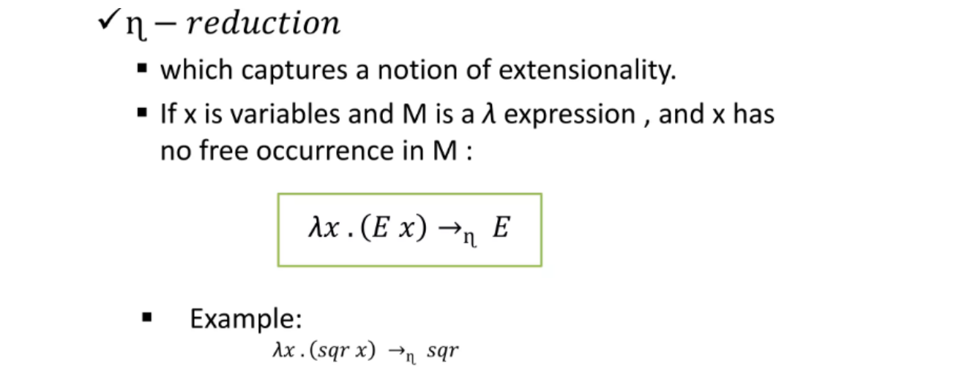
ETA-REDUCTION
10

Slide 11
LITERATURE REVIEW
SR NO. | TITLE | YEAR | AUTHUR'S | SUMMARY
01 | Lambda Calculus as a Workflow Model | 2008 | Peter M. Kelly; Paul D. Coddington; Andrew L. Wendelborn | This paper explains why lambda calculus is an appropriate model for workflow representation. The presented approach also permits high-level workflow features to be implemented at user level, in terms of a small set of low-level primitives provided by the language implementation
02 | The Impact Of The Lambda Calculus In Logic And Computer Science | 2014 | Rodrigo Machado | Lambda calculus is a system based on function definition and function application. It is a minimalistic Turing-computable system which influenced design of functional programming. This paper is a tutorial on the untyped lambda calculus and its use as an idealised programming language
11

Slide 12
LITERATURE REVIEW
SR NO. | TITLE | YEAR | AUTHUR'S | SUMMARY
03 | An Introduction to Lambda Calculus | 2007 | Gergely Dévai, Zoltán Csörnyei | Introduced the reader to the basics of λ-calculus: its syntax and transformation rules also discuss the most important properties of the system related to normal forms of λ-expressions.
04 | The Impact Of The Lambda Calculus In Logic And Computer Science | 1997 | HENK BARENDREGT | Presented the genesis of this theory and its two major areas of application: the representation of computations and the resulting functional programming languages on the one hand and the representation of reasoning and the resulting systems of computer mathematics on the other hand.
11

Slide 13
CASE STUDY
Lambda Calculus application in NLP
Represent natural language expressions by formalizing their meaning as a lambda expression.
This representation can then be used for tasks such as semantic analysis, question answering, and language generation.
Lambda calculus in semantic analysis
"John eats an apple“
(λx. eats(john, x))(apple)
“Apple” is applied to eats for prediction with subject "John".
Expression is simplified using beta-reduction
Substituting a "apple" for the variable "x"
eats(john, apple)
eats(john, apple)
15

Slide 14
CASE STUDY
Lambda calculus in natural language generation
used to generate text from a semantic representation
(λx. eats(john, x))(apple)
used to generate the text "John eats an apple" using a set of generation rules.
Provides a flexible and powerful framework for representing complex semantic relationships, such as quantification, negation, and scope
It is it easy to implement and manipulate in computational systems
15

Slide 15
ADVANTAGES OF LAMBDA CALCULAS
Simplicity
Flexibility
Efficiency
Expressiveness
16

Slide 16
DISADVANTAGES OF LAMBDA CALCULAS
Complexity
Limited Practicality
Limited Support for object-oriented programming
Performance
17

Slide 17
CONCLUSION
Lambda Calculus is a formalism for representing and manipulating functions.
Its simplicity and universality make it a valuable tool for studying computation theory and functional programming.
Understanding the principles of Lambda Calculus can provide insights into the foundations of computer science and programming.
Despite its limitations, Lambda Calculus remains an important tool for those interested in exploring the foundations of computer science and mathematics
18

Slide 18
REFERENCE
https://brilliant.org/wiki/lambda-calculus/
https://plato.stanford.edu/entries/lambda-calculus/
19

Slide 19

THANK
YOU

